Slide 1

GARS Workshop
February 15,2022
Digital Modes for Amateur Radio (Part-1)
Bob Hensey K4VBM
Dallas’ Notes on installing K9DUR’s UTCclock

Slide 2
Ray Andrews K9DUR - Amateur Radio Software
Download and Configuration
https://k9dur.us/misc_utilities.php
Scroll down until you find this:
UTCclock (v1.1.1 -- Released: 11/01/2020) -- This program displays the
current UTC time and/or your local time (as set in your PC). A programmable
countdown timer (10-minute ID timer) is included.
Download the User's Guide for more information about the program.
After the file is downloaded, click on it to start the install

Slide 3
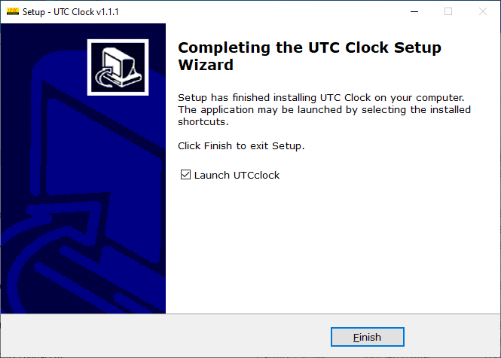
Take the defaults
Click on Finish

Slide 4
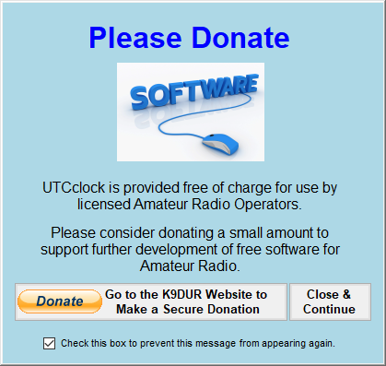
Donate if you want…
Check the box at the bottom

Slide 5
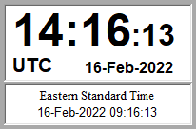
What you get
Right Click on the Clock to move it
Use the Hammer and Wrench icons to change settings
Note:
This UTC clock uses your PCs system clock
Use it with a service such as the Meinberg Network Time Protocol
Put it in your Start Menu if you want it to start when you start your PC

